Slide 1

Period End Closing Execution (BSC)
Period End Closing Key Process Areas and New Period End Checks
Posting Period Control
Intercompany and Period End Closing
Lease Accounting and Period End Closing
Cost Management Closing Activities
Period End Closing for Accruals and Recurring Entries
Period End Data Checks
Asset Accounting Closing Activities
VAT Clearing and Reporting
GR/IR Closing Activities
Material Ledger Closing (Non-GSC Activities)
Automatic Clearing of LSC¹⁾ Accounts
G/L Closing Activities for Financial Statement Preparation
¹⁾ LSC – Accounts with indicator “Clearing Specific to Ledger Groups” active.

Slide 2
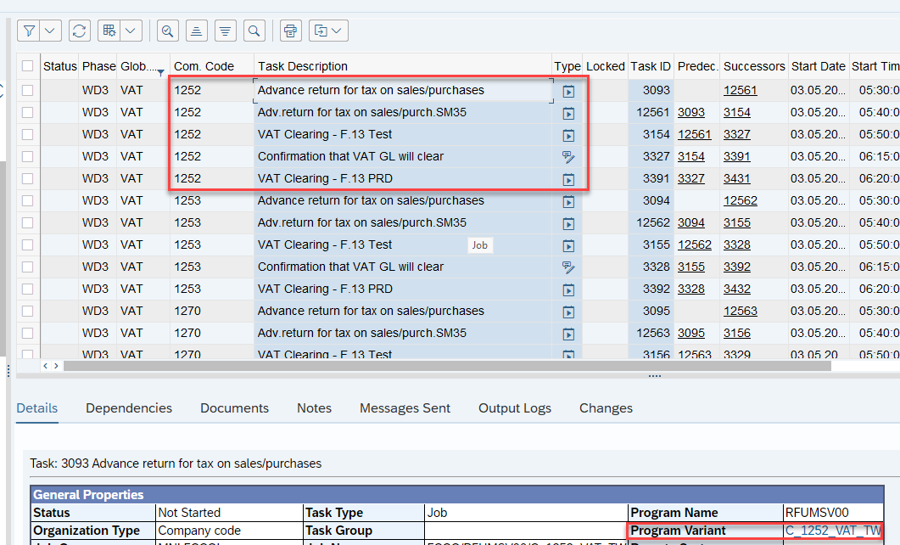
VAT Clearing and Reporting
Basic Process of VAT at Period End
In S/4HANA, the VAT period end process has not changed from ECC
VAT Regrouping via S_ALR_87012357
Check VAT account balances and reclass if needed
Auto-clear VAT accounts via F.13
Prior to VAT Regrouping via S_ALR_87012357 report, some entities have processes such as Deferred Tax Transfer via F.38 for Romanian entities, VAT transfer via ​ZRUSECEVENT for Russian and Belarus, and Deferred Tax Transfer via S_ALR_87012360 for Philippines. ¹⁾
S_ALR_87012357 re-classes the balances on Input and Output VAT accounts for each VAT registration to the Due/Recoverable account at period close.
If there’s any balance left in LC1 in input/output VAT accounts then a GL journal is posted to remove them.
VAT Accounts are Open Item Management accounts, which should be cleared prior to Revaluation/Translation processes.
The process is automated in FCC with a Test Run, followed by a note task to confirm successful test run, which then triggers the update run task
T-Code:
S_ALR_87012357 ¹⁾ F.13
In S/4 HANA, VAT accounts continue to be posted ledger-through as they are related to sales and purchase postings which are ledger-through. As a result all the VAT regrouping/reclassification/transfer/clearing transactions make postings to all ledgers at the same time.
Note that there are also other VAT reports (e.g. EC Sales, Intrastat – on Fiori) used by indirect tax users at period ends, which are not part of Parallel Ledger closing process and not recorded in FCC.
FCC Task: Entity Level
VAT closing tasks are set at entity level to allow flexibility within each entity, as some have a number of tax registrations in different countries which require longer time to complete.
Timing: WD3
VAT closing activities are performed on WD3 before Revaluation process.
¹⁾ Refer to existing GBS/JTBC process documentation for the country specific process steps.

Slide 3
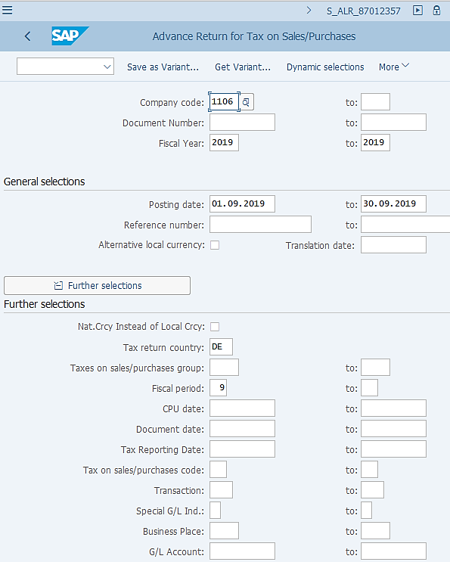
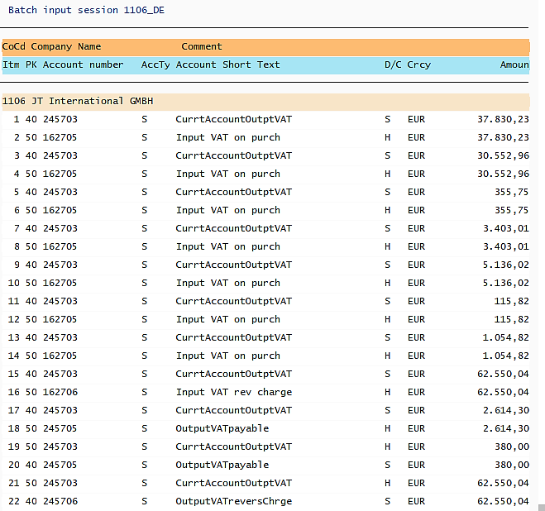
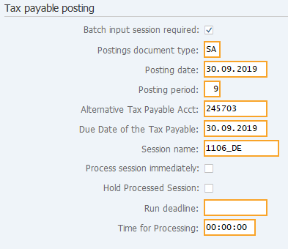
VAT Regrouping S_ALR_87012357: Execution
S_ALR_87012357 is executed via FCC as an entity level task using a Company Code variant specific to each company code.
There’s no change from ECC to S/4 HANA in executing this transaction. There should be a variant set up for each Tax Registration for each entity. This is specially critical for company codes in Europe, which tend to have several tax registrations.
The Posting Parameters of the transaction determines the VAT Due/Recoverable G/L account to be used for VAT Regrouping. Make sure your variants always include the correct VAT Due/Recoverable account for each Tax Registration.
The batch input SM35 task is also incorporated in FCC. GL team may display the session to check the posted document number.
SM35
It is worth knowing that the Indirect Tax users in entities and GBS VAT Compliance teams also use the same report. When they execute it they would ensure the output layouts meet their reporting requirements which supports VAT returns, while no Posting Parameter is entered as shown on our screenshot because they run the report for reporting compliance purposes rather than for VAT Regrouping postings.

Slide 4
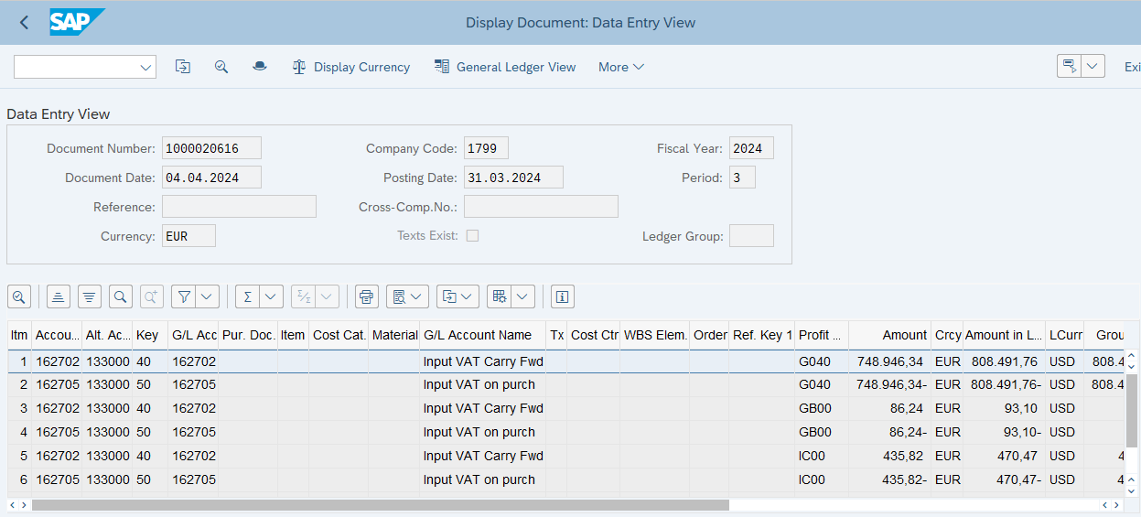
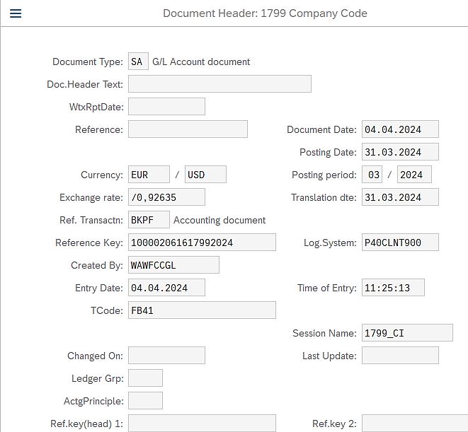
VAT Regrouping S_ALR_87012357: Postings
FB03: Display FI Documents
You can find the VAT Regrouping document number from the processed SM35 session or search in FB03 using the unique features of such document, e.g. the Document Type, Session Name, Tcode, etc., along with the Posting Date, Document Date, etc. information. As you can see from the above screenshot, the document shows that it was posted by the FCC account (WAWFCCGl for Warsaw GBS), under the session name defined in the variant used in the S_ALR_87012357 task in FCC.
T-Code FB41 is used because automatic Input and Output VAT accounts do not allow direct posting without tax code via any other T-Code.
The VAT Regrouping documents are posted ledger-through, as you can see from the above screenshot, with blank “Ledger Group”.
In S/4 HANA, all Balance Sheet Accounts are posted with Profit Centers, which are also present in the VAT Regrouping postings. Please note that when you display in Ledger View for each ledger, you will see the Document Splitting effect as part of the Market Free Cash Flow requirement.

Slide 5
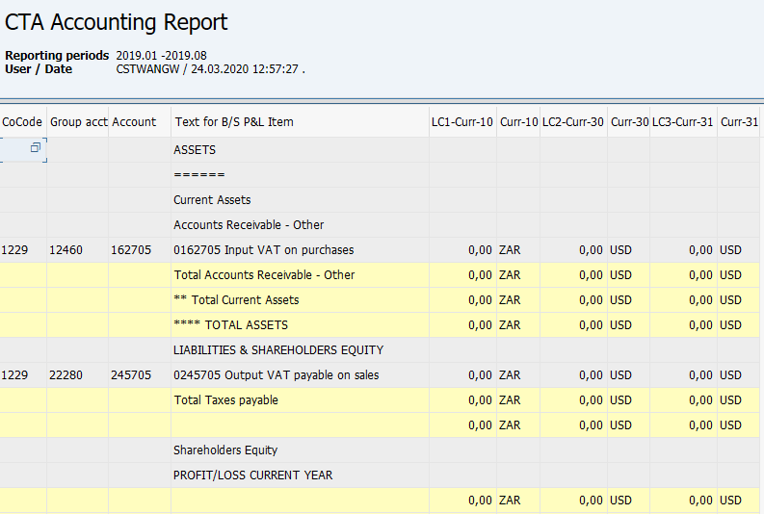
Check VAT Account Balances and GL Journal
ZFGL_CTA Report
Prior to automatic clearing of Input/Output VAT accounts, GBS/JTBC perform a check of LC1 balance in these automatically posted VAT accounts. Technically many reports in the system can be used, such as ZFGL_CTA, which is demonstrated here.
The check can be performed either before or after the test run of F.13, because if there are LC1 balances left in Input/Output VAT accounts, the test run of F.13 will show that they can’t be cleared.
If LC1 balances are found, then a MyRequest GL Journal ¹⁾ template needs to be raised and posted to remove these balances. This is currently done by GBS WAW and MNL for their entities, while GBS St. Pete advises their entities to submit the correction MyRequest template.
After the GL Journal, you can re-run ZFGL_CTA, which should show a similar picture like the screenshot, i.e. all local currency balances in VAT Input and Output Accounts should be zero.
¹⁾ Refer Parallel Ledger training materials for the G/L Journal process in S/4HANA.

Slide 6
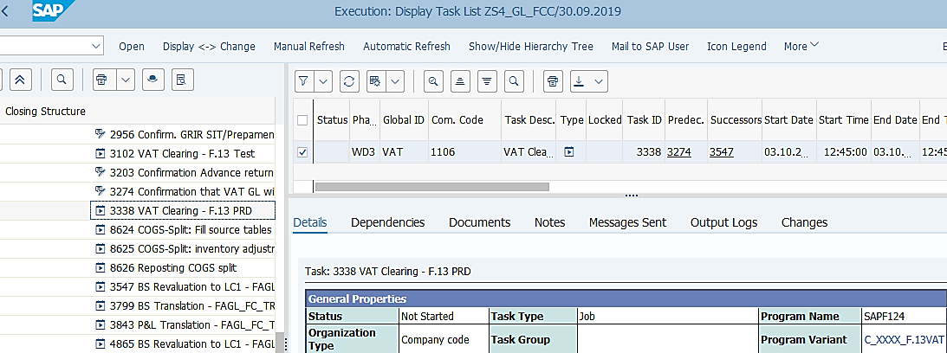
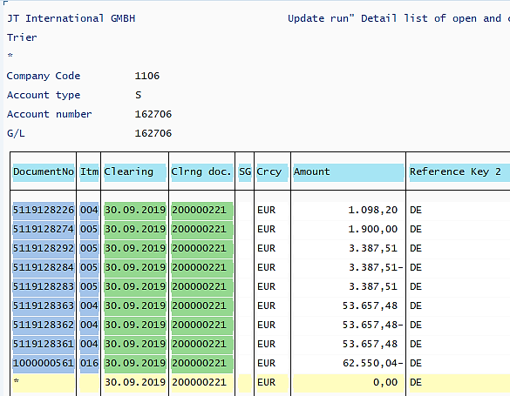
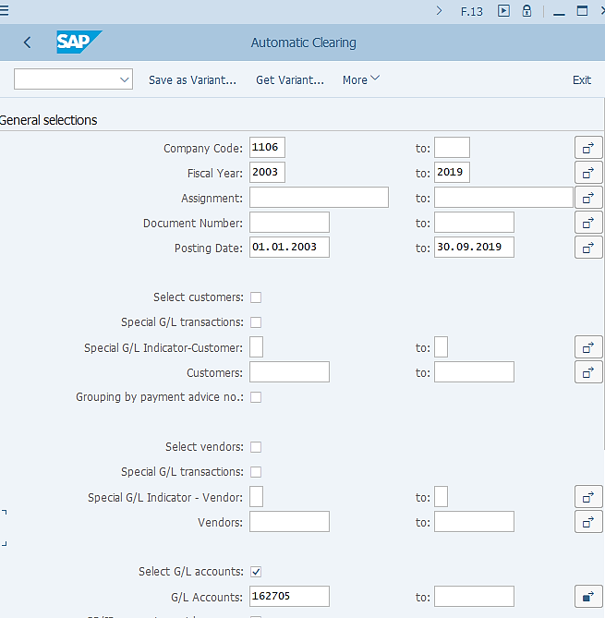
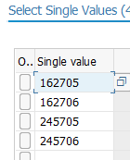
VAT Account Automatic Clearing
FCLOCO: FCC Task List
F.13: Automatic Clearing
This is a “global” variant using Company Code and dates/years variables. Please review/amend Company Code and relevant Date/Year fields when using it outside of FCC.
With the balances of the VAT Input and Output accounts being zero or brought to zero if a GL journal was posted in case of LC1 balances, these accounts can then be cleared via F.13 – Automatic Clearing.¹⁾ The F.13 Test Run task allows you to check if the accounts can be cleared. Then GL team should confirm the next “Note” task to confirm that F.13 will clear, which will trigger the F.13 production run task in FCC.
Every account which needs to be automatically cleared should have its automatic clearing criteria defined. In the case of VAT Input and Output accounts, this criterion is Reference Key 2, which indicates the Tax Registration country. This means for items posted to the same VAT account and with the same Reference Key 2, if their total balance is zero then these items will be automatically cleared.
¹⁾ Refer to Parallel Ledger training materials for the Automatic clearing process using T-Code F.13.

Slide 7
VAT F.13 Automatic Clearing – Common Errors
F.13 is not only used for Automatic Clearing of VAT accounts, but many accounts, such as GR/IR accounts.
The following common errors may occur during both Test Run and Update Run:
F.13 Transaction Common Errors | Error Reason | Error Resolution
FX clearing accounts are not setup for clearing | FX clearing accounts are not setup in the system for clearing | Contact the Market and ask them to raise the RITM request via the IT Service Portal. Once the request is completed the task can be re-run or executed manually
The difference is too large for clearing | The system confirms that the clearing criteria were not met due to difference in clearing process | No action to be taken, we can ignore the message
No G/L account documents selected | Not a real error, message informing that there is no posting to be cleared for the selected account | No action to be taken, we can ignore the message

